Slide 1


Data Analysis: Project Budget to Actual
By: Shubham Trivedi

Slide 2
Observations
Which project’s Actuals are Under or Over Budgeted Costs?
Project Name | Under or Over | By how much?
Project A | Over | $ 14,550
Project B | Over | $ 4,500
Project C | Over | $ 27,300
Project D | Under | $ 19,500
Project E | Under | $ 36,240

Slide 3
Observations
Which project’s Actuals are Under or Over Budgeted Hours?
Project Name | Under or Over | By how much Hours?
Project A | Over | 204
Project B | Over | 108
Project C | Over | 318
Project D | Under | 144
Project E | Under | 366

Slide 4
Observations
Which personnel Is paid the most and least?
Personnel Name | MAX or MIN | how much is Paid in Total?
Crystal | MAX | $ 600
Sondra | MIN | $ 45

Slide 5
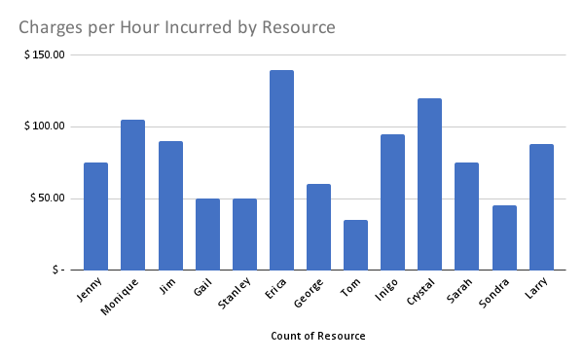
Observations
Which personnel Is Costing us the most and least?
Personnel Name | MAX or MIN | Average Cost of the resource?
Erica | MAX | $ 140
Tom | MIN | $ 35

Slide 6
Observations
Which personnel’s Actual hours are Over, Under or as per Budgeted hours?
Personnel Name | SUM of Budget hours | SUM of Actual hours | Budget vs Actual | By how much?
Crystal | 900 | 900 | As Budgeted | 0
Erica | 960 | 900 | Under Budget | 60
Gail | 930 | 1026 | Over Budget | -96
George | 960 | 1200 | Over Budget | -240
Inigo | 960 | 660 | Under Budget | 300
Jenny | 960 | 1020 | Over Budget | -60
Jim | 960 | 1050 | Over Budget | -90
Larry | 960 | 480 | Under Budget | 480
Monique | 960 | 1200 | Over Budget | -240
Sarah | 960 | 1020 | Over Budget | -60
Sondra | 960 | 960 | As Budgeted | 0
Stanley | 720 | 864 | Over Budget | -144
Tom | 960 | 990 | Over Budget | -30

Slide 7
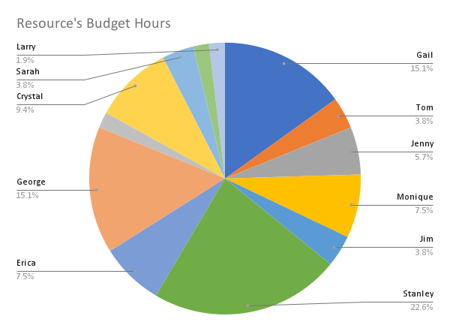
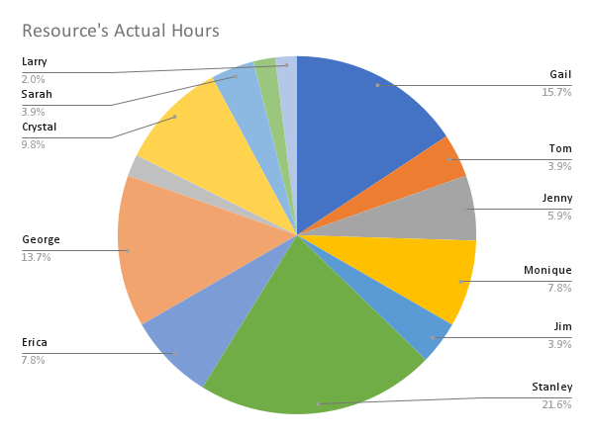
Observations
Which personnel is better at budgeting their hours?
Near the percentage of specific personnel on both charts better is their ability to budget their hours.
Here, Larry, Sarah, Jim, and Tom are most accurate when listing their hours for the budget.

Slide 8
Observations and Key Insights
To sum up the data we looked at earlier, some insights that we gathered are as follows:
Project A&C are being very over budgeted, and that money can be funneled to other projects which are under-budgeted or for the use of new project altogether. But, one more recommendation by me would be to not funnel all the amount that was over budgeted, but rather keep some over budgeted money as a buffer, it can be possible that those personnels would have detected some edge case that may be encountered which requires more effort.
In terms of budgeted hours, overly budgeted hours cannot be transferred as a financial resource. Therefore, we can distribute human resources which were over budgeting their share of hours to under-budgeted tasks for various projects.
We have paid most to Crystal and least to Sondra.
In terms of costly resources, Erica is the costliest resource in our team, she costs $ 140 per hour on average. And Tom is the cheapest resource at $ 35 per hour.
From the data it looks like some of our resources need training in budgeting their hours properly as their offset of budgeting is more than 100 hours in 6 months duration. Namely, George, Inigo, Larry, Monique, and Stanley.

